Slide 1


Introduction to Natural Language Processing, Regular Expressions, and Tokenization
A Flexible and Iterative Approach to Software Development
NAME :
UNIVERSITY ROLL NO:
PAPER NAME : Natural Language Processing PAPER CODE : PEC-AIML 801A
SEMESTER/YEAR : 8TH SEM/ 4th YEAR DEPARTMENT :CSE(AI&ML)

Slide 2
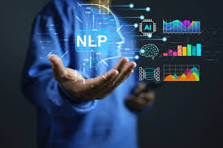
What is Natural Language Processing (NLP)?
Definition: NLP is a subfield of Artificial Intelligence (AI) that focuses on the interaction between computers and humans through natural language.
Goals of NLP:
Enable machines to read, understand, and derive meaning from human languages.
Facilitate human-computer interaction in a way that is natural and intuitive.
Key Components:
Syntax: Structure of sentences.
Semantics: Meaning of words and sentences.
Pragmatics: Contextual use of language.
Discourse: How preceding sentences influence the interpretation of the next ones.
Importance: With the exponential growth of data generated in textual form, NLP allows for effective data analysis and decision-making.

Slide 3
Real-World Applications of NLP
Virtual Assistants:
Examples include Siri, Google Assistant, and Alexa. They use NLP to understand user queries and provide relevant responses.
Machine Translation:
Services like Google Translate utilize NLP algorithms to translate text between languages while preserving meaning.
Sentiment Analysis:
Businesses analyze customer feedback on social media or reviews to gauge public sentiment about products or services.
Spam Filtering:
Email services use NLP techniques to identify and filter out spam messages based on content analysis.
Text Summarization:
Algorithms automatically condense large documents into concise summaries while retaining key information.
Information Extraction:
Extracting structured information from unstructured data sources like news articles or research papers.

Slide 4
How NLP Works - The Process of NLP
Data Preprocessing:
Cleaning and preparing text data for analysis. This includes:
Removing punctuation, special characters, and stop words (common words like "and," "the").
Normalizing text through lowercasing or stemming (reducing words to their root form).
Tokenization (breaking text into words or phrases).
Algorithm Development:
Using rule-based systems or machine learning models:
Rule-based systems rely on predefined linguistic rules (e.g., grammar rules).
Machine learning models learn patterns from data (e.g., supervised learning with labeled datasets).
Evaluation Metrics:
Precision, Recall, F1 Score, and Accuracy are used to evaluate model performance. For example:
Precision = True Positives / (True Positives + False Positives)
Recall = True Positives / (True Positives + False Negatives)

Slide 5
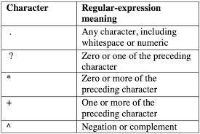
Introduction to Regular Expressions (Regex) in NLP
Definition: A regular expression is a sequence of characters that defines a search pattern. It is used for string matching within texts.
Components of Regex:
Literal Characters: Match themselves (e.g., a, b, 1).
Met characters: Special characters with specific meanings (e.g., ., *, +, ?, ^, $).
‘.’ matches any character except newline.
‘*’ matches zero or more occurrences of the preceding element.
‘+’ matches one or more occurrences of the preceding element.
‘?’ makes the preceding element optional.
‘^’ asserts position at the start of a line.
‘$’ asserts position at the end of a line.
Applications in NLP:
Data validation (e.g., checking email formats).
Text parsing and extraction (e.g., extracting dates or phone numbers).

Slide 6
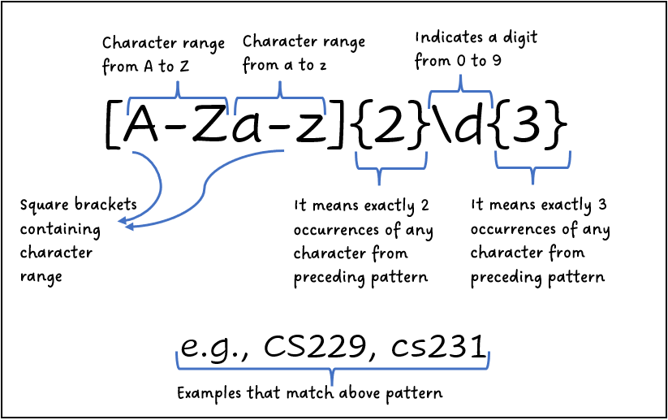
Regular Expression Examples
Here are five practical examples of regular expressions:
Example 1: Matching email addresses - \b[A-Za-z0-9._%+-]+@[A-Za-z0-9.-]+\.[A-Z|a-z]{2,}\b
Matches valid email formats like example@example.com.
Example 2: Matching phone numbers - \d{3}-\d{3}-\d{4}
Matches phone numbers formatted as 123-456-7890.
Example 3: Matching dates (MM/DD/YYYY) - (0[1-9]|1[0-2])/(0[1-9]|\d|3)/\d{4}
Matches dates like 12/31/2025.
Example 4: Removing HTML tags - <[^>]+>
Matches any HTML tag like <div> or <p>.
Example 5: Finding all words starting with 'un‘ - \bun\w+
Matches words like unhappy, undo, etc.

Slide 7
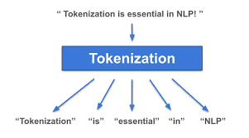
Tokenization in NLP
What is Tokenization?
Tokenization is the process of breaking down text into smaller units called tokens. These tokens can be words, phrases, symbols, or other meaningful elements.
Importance:
It simplifies text analysis by converting unstructured text into structured data that can be easily processed by algorithms.
Types of Tokens:
Words | Sentences | Sub words | Characters
Challenges:
Handling punctuation, contractions (e.g., "don't" vs. "do not"), and special characters can complicate tokenization.

Slide 8
Types of Tokenizers
1. Word Tokenizer:
Splits text into individual words based on spaces and punctuation.
Example using Python's NLTK library:
from nltk.tokenize import word_tokenize
text = "Hello world! This is NLP."
tokens = word_tokenize(text)
# Output: ['Hello', 'world', '!', 'This', 'is', 'NLP', '.']
2. Sentence Tokenizer:
Splits text into sentences based on punctuation marks like periods, exclamation points, etc.
Example using NLTK:
from nltk.tokenize import sent_tokenize
text = "Hello world! This is NLP. Let's learn."
sentences = sent_tokenize(text)
# Output: ['Hello world!', 'This is NLP.', "Let's learn."]

Slide 9
Types of Tokenizers
3. Regular Expression Tokenizer:
Uses regex patterns to define how tokens are split from the text.
Example using Python's re module:
import re
text = "Hello world! This is NLP."
tokens = re.findall(r'\w+', text)
# Output: ['Hello', 'world', 'This', 'is', 'NLP']
4. Subword Tokenizer:
Splits words into subwords to handle unknown words effectively. Often used in neural network models like BERT and GPT.
Example with Byte Pair Encoding (BPE):
The word “unhappiness” could be tokenized as ["un", "happi", "ness"].

Slide 10
Tokenizer Examples in Detail
1. Word Tokenizer Example:
Input Text:
"The quick brown fox jumps over the lazy dog.“
Output Tokens:
["The", "quick", "brown", "fox", "jumps", "over", "the", "lazy", "dog", "."]
2. Sentence Tokenizer Example:
Input Text:
"This is sentence one. This is sentence two."
Output Sentences:
["This is sentence one.", "This is sentence two."]
3. Regex Tokenizer Example:
Pattern Used: \w+
Input Text:
"Hello, world!"
Output Tokens:
["Hello", "world"]
4. Subword Tokenizer Example:
Input Word: "unhappiness"
Output Subwords:
["un", "happi", "ness"]
5. Character Tokenizer Example:
Input Text:
"Hi!"
Output Characters:
["H", "i", "!"]

Slide 11
THANK YOU
for your
attention!

